Slide 1


Bayesian neural networks
贝叶斯神经网络

Slide 2

目录
不确定性（Uncertainty）
为什么我们需要Bayesian Neural Networks
论文《Weight Uncertainty in Neural Networks》
Bayes by Backprop：
A simple approximate learning algorithm similar to backpropagation
不确定性（Uncertainty）
单击此处添加内容
单击此处添加内容
单击此处添加内容

Slide 3
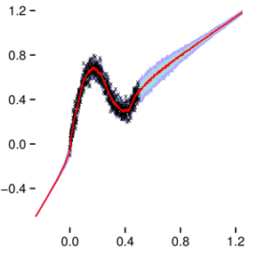
不确定性（Uncertainty）
Why do we need Uncertainty
High risk applications (无人驾驶、航空航天领域）
Out of data samples
Improving the model

Slide 4
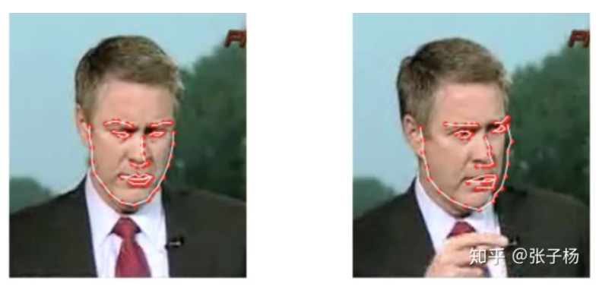
不确定性（Uncertainty）
偶然不确定性（ Aleatoric Uncertainty）
无法被避免的一类误差，并不是由模型带入，而是数据本来就存在误差。
认知不确定性（ Epistemic Uncertainty）
模型中存在的不确定性，其测量数据是否存在于已经见过的数据的分布之中。

Slide 5
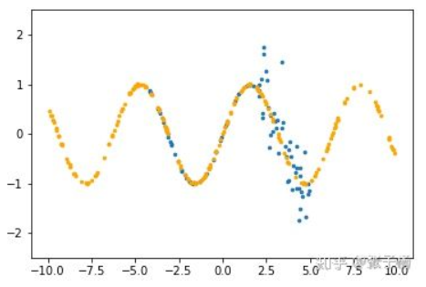
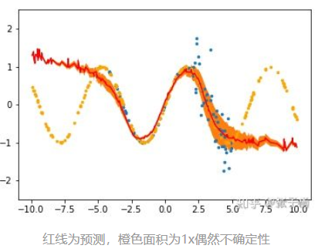
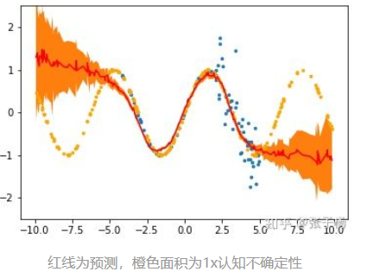
不确定性（Uncertainty）
简单的sin函数，蓝色是训练数据，橙色是测试数据
在区间[2.5,5.0]内，对训练数据施加一个高斯噪声
偶然不确定性:
认知不确定性:

Slide 6
不确定性（Uncertainty）
偶然不确定性衡量了观测中固有的噪声。 这种类型的不确定性存在于数据收集中，即使收集更多数据，也不能减少不确定性。
认知不确定性是模型本身造成的不确定性，给定更多数据可以减少认知不确定性。
可以通过在模型参数或模型输出上加入概率分布来估计不确定性。 通过在模型的权重上加入先验分布，然后尝试捕获这些权重在给定数据的情况下变化多少来对认知不确定性建模。

Slide 7
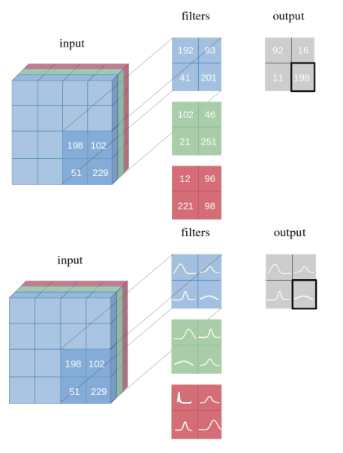
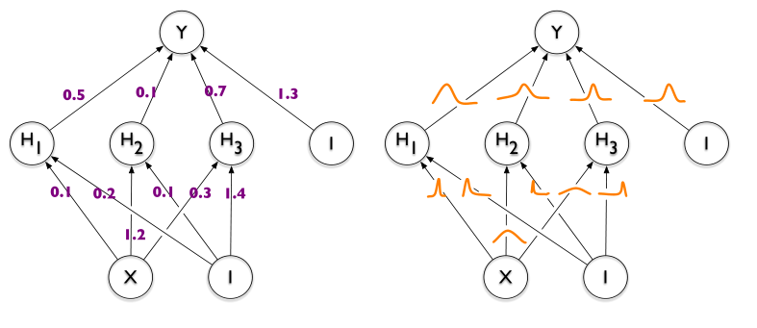
为什么我们需要 Bayesian Neural Networks
从概率论的角度来说，使用点估计作为权重是不合理的。

Slide 8
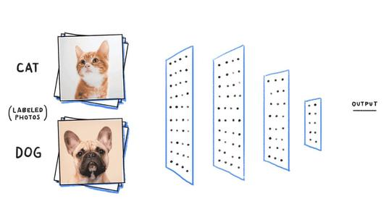
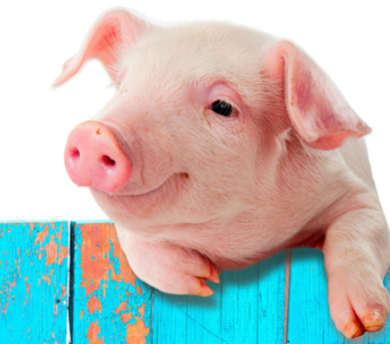
为什么我们需要 Bayesian Neural Networks
神经网络存在两个主要问题：
容易过拟合
对预测结果过于自信
softmax

Slide 9
为什么我们需要 Bayesian Neural Networks
真的需要贝叶斯神经网络吗？
在工程实践中我们用各种正则化技巧去控制过拟合，比如，提前终止迭代，权重衰减、L1或者L2正则化
如果我们通过对模型进行正则化可以解决决策置信度过高并且防止模型过拟合，那么问题仍然存在：为什么我们需要贝叶斯神经网络？
答案是需要，因为当前神经网络中缺少预测中的不确定性度量，但贝叶斯神经网络将其纳入其中。

Slide 10
为什么我们需要 Bayesian Neural Networks
引入贝叶斯的概念在神经网络中可以解决以上问题
将权重作为随机变量看待，不易过拟合。
贝叶斯神经网络在小型数据集上也能很好的学习。
先验的加入相当于给网络提供了一种约束和正则，Dropout 在分析中也被认为是贝叶斯神经网络的一种形式。
贝叶斯神经网络能够产生不确定性的度量，而非仅给出一个判别结果。

Slide 11
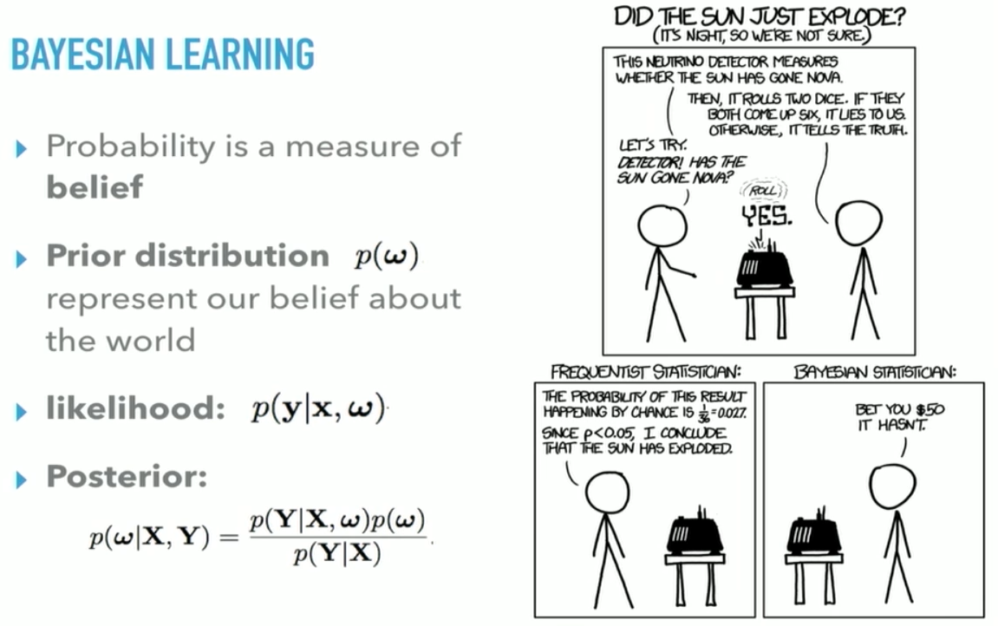
为什么我们需要 Bayesian Neural Networks
“当事实改变，我的观念也跟着改变，你呢？”
——John Maynard Keynes

Slide 12
《Weight Uncertainty in Neural Networks》
作者：Charles Blundell, Julien Cornebise, Koray Kavukcuoglu and Daan Wierstra [Google DeepMind]
内容：普通的前馈神经网络容易过拟合，不能处理数据中的不确定性，因此提出怎么样建模深度学习中的不确定性
方法：提出了Bayes by Backprop （BBB）

Slide 13
How to prevent overfitting
Various regularization schemes have been developed to prevent overfitting in neural networks:
Early stopping
Weight decay
Dropout
This paper addressed this problem by using variational Bayesian learning to Introduce uncertainty in the weights of the network.
Bayes by Backprop

Slide 14
Contribution
They proposed Bayes by Backprop
A simple approximate learning algorithm similar to backpropagation
All weights are represented by probability distributions rather than having a single fixed value.
It achieves good results in several domains.
Classification
Regression
Bandiit problem

Slide 15

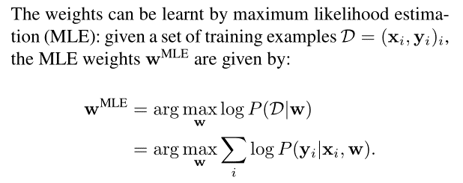
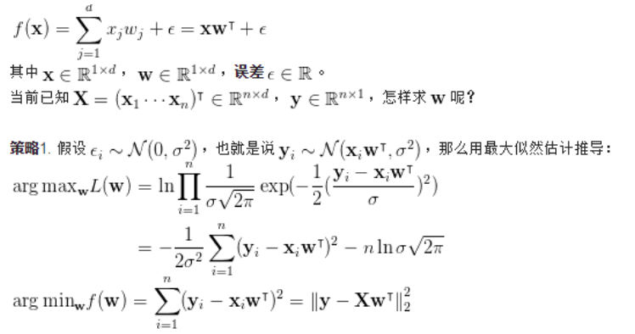

Point Estimates of NN
最大似然估计（Maximum Likelihood Estimation, MLE）
Neural Network is a probabilistic model $P(y|x,w)$

Slide 16
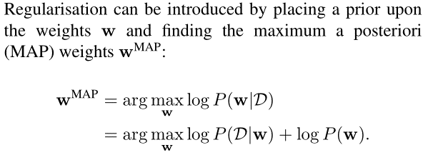
Point Estimates of NN
最大后验估计（Maximum Posteriori, MAP）
MLE

Slide 17


Bayesian estimation
The predictive distribution: 𝑃(𝑦 ̂|𝑥 ̂)
an unknown label: 𝑦 ̂
a test data item: 𝑥 ̂
$P\left(\hat{y} | \hat{x}\right)=\int{P\left(\hat{y} | \hat{x},w\right)p\left(w | D\right)dw=𝔼_{P\left(w | D\right)}}$[$P\left(\hat{y} | \hat{x},w\right)$]
Taking an expectation = an ensemble of an uncountably infinite number of NN
Intractable（难解的）

Slide 18
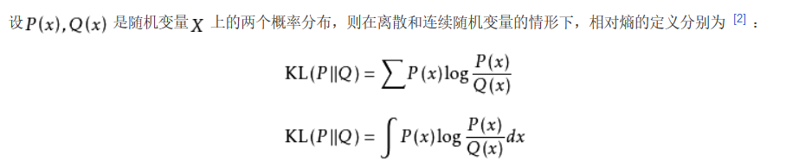
Variational learning
KL divergence（ KL散度）
在概率论或信息论中，KL散度又称相对熵(relative entropy)，是描述两个概率分布P和Q逼近程度的一种方法。

Slide 19
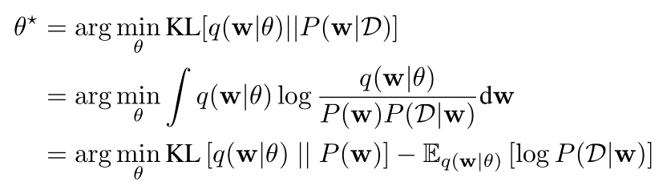
Variational learning
Variational learning finds the parameters θ of a distribution on the weights q(w|θ) that minimises the Kullback-Leibler (KL) divergence with the true Bayesian posterior on the weights.

Slide 20
Variational learning
Graphical Intuition defined by Graves (2011). Source

Slide 21


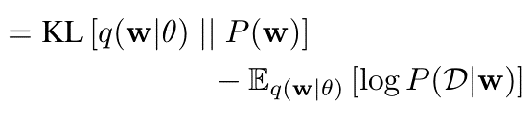
Variational learning
The resulting cost function is known as the variational free energy or the expected lower bound(ELBO)
prior-dependent part
（complexity cost）
data-dependent part
（likelihood cost）

Slide 22
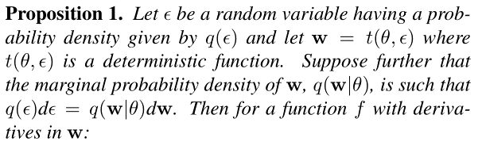
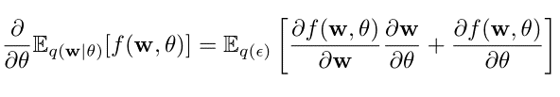
Unbiased Monte Carlo gradients
Under certain conditions, the derivative of an expectation（期望的导数） can be expressed as the expectation of a derivative（导数的期望）
A generalisation of the Gaussian reparameterisation trick

Slide 23



Unbiased Monte Carlo gradients
We apply Proposition 1 to the optimisation problem in
Let
Using Monte Carlo sampling to evaluate the expectations, a backpropagation-like algorithm is obtained for variational Bayesian inference in neural networks – Bayes by Backprop – which uses unbiased estimates of gradients of the cost to learn adistribution over the weights of a neural network.

Slide 24

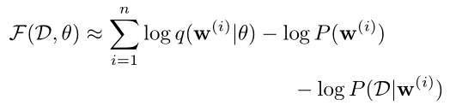
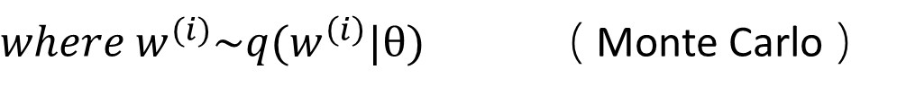
Unbiased Monte Carlo gradients
We approximate the exact cost as
$where w^{(i)}\sim q(w^{\left(i\right)}|θ)$ （ Monte Carlo ）
Every term of this approximate cost depends upon the particular weights drawn from the variational posterior

Slide 25
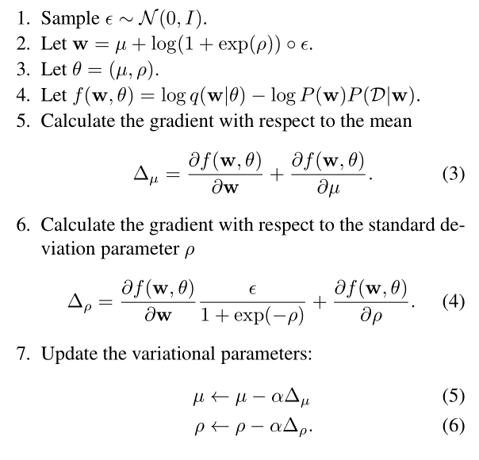
Gaussian variational posterior

Slide 26

Scale mixture prior
They propose using scale mixture of two Gaussian densities as the prior
Empirically they found optimising the parameters of a prior P(w) to not be useful, and yield worse results.
it can be easier to change the prior parameters than it is to change the posterior parameters
the prior parameters try to capture the empirical distribution of the weights at the beginning of learning
pick a fixed-form prior and do not adjust its hyperparameters

Slide 27



Minibatches and KL re-weighting
The minibatch cost for minibatch i= 1,2,…,M
Then
works well
the first few minibatches are heavily influenced by the complexity cost
the later minibatches are largely influenced by the data

Slide 28
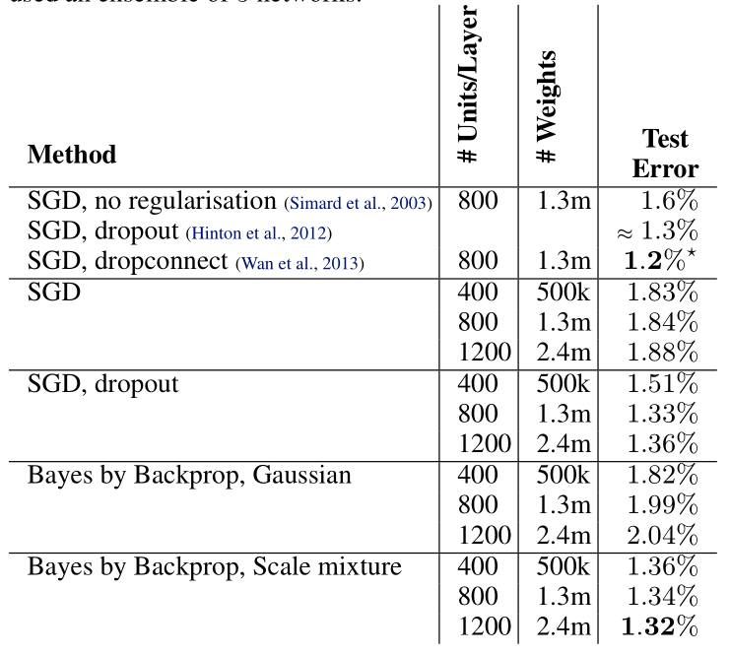
Classification on MNIST
Classification Error Rates on MNIST

Slide 29
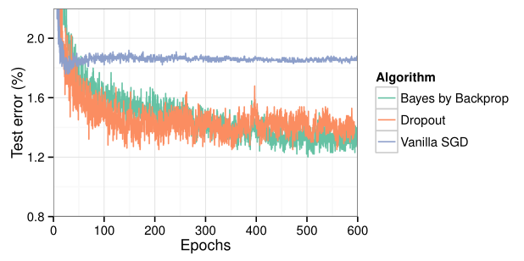
Classification on MNIST
Test error on MNIST as training progresses
SGD converges the quickest
Bayes by Backprop and dropout converge at similar rates
Eventually Bayes by Backprop converges on a better test error than dropout after 600 epochs

Slide 30
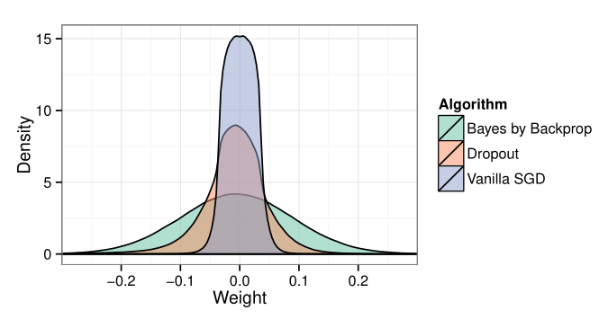
Classification on MNIST
Density estimates of the weights
Bayes by Backprop weights are sampled from the variational posterior
Dropout weights are those used at test time
Bayes by Backprop uses the greatest range of weights.

Slide 31
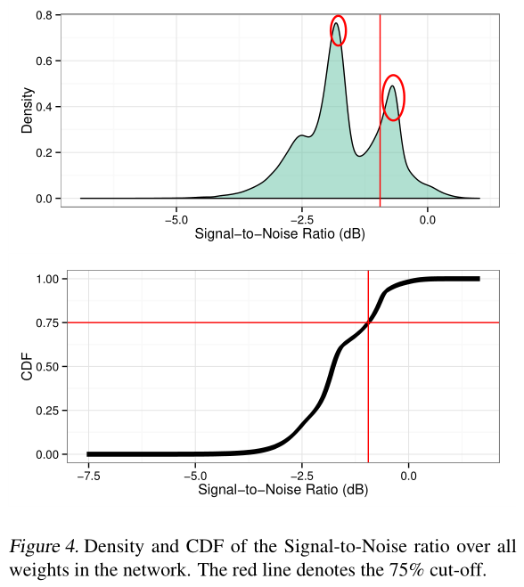
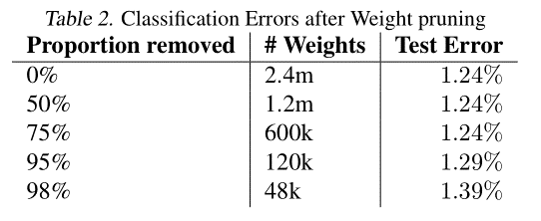
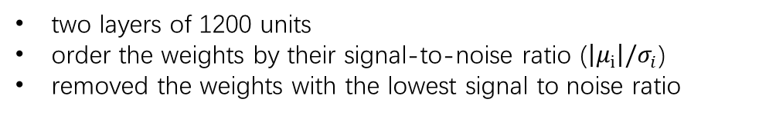
Classification on MNIST
The level of redundancy in the network found by Bayes by Backprop
replacing the variational posterior on some of the weights with a constant zero
two layers of 1200 units
order the weights by their signal-to-noise ratio ($\left|μ_{i}\right|/σ_{i}$)
removed the weights with the lowest signal to noise ratio

Slide 32
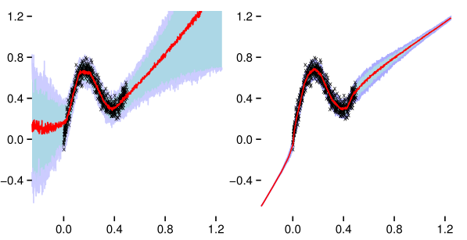

Regression
We generated training data from the curve:
$$where ε\sim N(0,0.02)$$

Slide 33
Conclusion
We introduced a new algorithm for learning neural networks with uncertainty on the weights called Bayes by Backprop.
It optimises a well-defined objective function to learn a distribution on the weights of a neural network.
The algorithm achieves good results in several domains.
MNIST: performance from Bayes by Backprop is comparable to that of dropout
Non-linear regression: the uncertainty introduced allows the network to make more reasonable predictions about unseen data
Contextual bandits: Bayes by Backprop can automatically learn how to trade-off exploration and exploitation

Slide 34
谢谢大家

